Slide 1
Intro to Unity
Pauline Belford

Slide 2
Why use Unity for asset creation?
We will be using Unity for asset-creation in this module. This asset will then be implemented into a AR application which will also be created using Unity.
The focus of this module is not on creating a game.
It is on creating an asset which you can then implement into your AR application in Module 3.
Unity has a physics engine, which makes it (relatively) easy to implement both realistic and creative assets with particular physical properties, modify and test those assets, without having to understand a lot of high-level mathematics and physics concepts and formulas.
It is useful to have some understanding of these concepts and formulas, to make it easier to know what to modify to achieve your desired effect. But it is not essential to have an in-depth knowledge of these domains.

Slide 3
Unity Resources
We will only be covering a very small amount of Unity in this module.
Unity’s own resources are excellent if you want to go deeper into certain topics.
Unity has it’s own learning tutorials, which can be worked through as a whole, or searched for specific topics (e.g. physics interactions)
https://learn.unity.com/
The Unity documentation is also a very useful resource.
https://docs.unity3d.com/2022.1/Documentation/Manual/UnityManual.html

Slide 4
Within a Unity Project
Firstly, we begin our Unity development with a ‘scene’.
These are the building blocks we use to develop the game.
Scenes can be used as menus, levels of games – anything that acts as a container for the things with which a player interacts.
Scenes consist, in part, as collections of ‘GameObjects”.
We can add these to the scene to create the interactive player experience.
GameObjects many be tangible in a virtual world.
Barriers, monsters, buildings.
They may be invisible repositories for code.

Slide 5
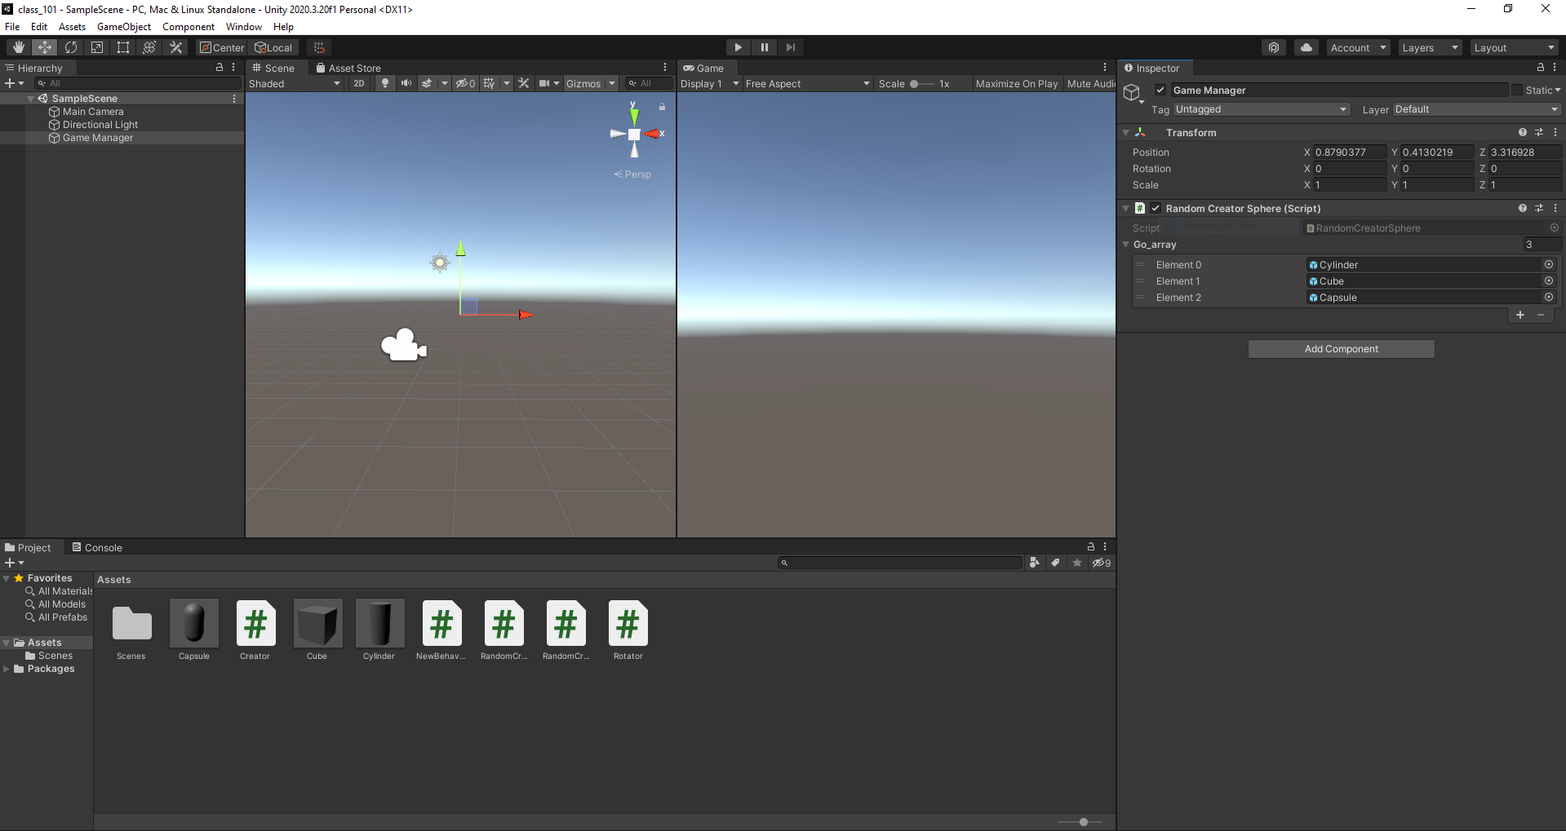

Slide 6
Within the Scene
The game objects you create within the scene belong to a 'hierarchy'.
This is a view of the objects, and which objects 'belong' to which other objects.
GameObjects can be parents to other objects.
When you position the parent, all children are also positioned relative to their parent(s).
The scene editor is basically a 3D editor for your game 'level'.
You can navigate through it, placing and rotating shapes, colouring them, applying textures, and so on.

Slide 7
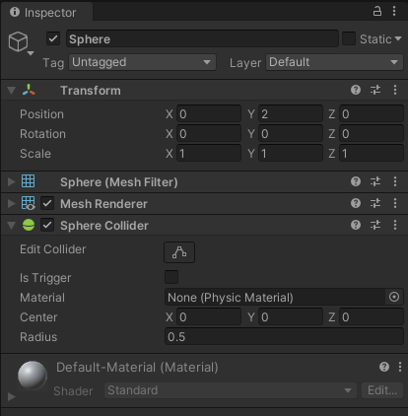
3D Positionality
Within Unity, we must get used to the 3D perspective.
Which can be a little challenging if you're not used to it.
We also must become familiar with the key mechanisms by which we manipulate objects.
Scaling, in which we change the dimensions in the X, Y or Z axes.
Rotation, in which we change the angle of rotation in the X, Y or Z axes.
Placement, in which we place the object in the X, Y or Z axes.
Unity allows us to do all of these from within the editor.

Slide 8
World, local and screen co-ordinates
Awkwardly, each object has several sets of co-ordinates.
Local co-ordinates, which are relative to an object’s own origin.
World co-ordinates, which are shared by everything in a scene
Screen co-ordinates, which are calculated from a camera projection of the world and condensed into two dimensions.
You may have cause to reference any, or all, of these.
Or none.

Slide 9
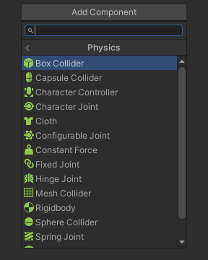
Object Properties
When selecting a game object, we get to set its properties.
These define how it looks and behaves within the game.
Here we can set textures, add code, and change the various 3D position to absolute values.
Which we may need, depending on what we're doing.
Some of these are defined by components attached to an object.
Some we’ll make available ourselves.
We’re going to be making use of some of the available physics components.

Slide 10
Packages
One of the reasons why Unity has become so popular is that it comes with a library of packages.
These are units of predefined functionality that we can easily drop into a project.
One of these packages is the FPSController.
This gives us controllers through which we can experience our game.
Through the packages we can also add terrains and other tools.
These are important, but are not our main focus just now.

Slide 11
Terrains
Terrains are the geography of our scene.
We add them like other game objects.
Within the terrain editor, we can adjust the topography.
Add cliffs, hills and mountains.
We can also apply 'textures'.
This lets us model different kinds of geography such as 'rock' and 'grass.
Unity lets us paint these on, and use any kind of image as a texture.
With occasionally horrifying results.
Textures can also be applied to game objects.
With equally horrifying results.
You will do this a different way in AR.

Slide 12
Lights and Cameras
The richness of graphical representation is in many ways driven by light.
Without light, 3D contours are not possible to discern.
Within unity, we have several kinds of light sources.
Directional, which work like a sun - infinitely far away and illuminates all objects in the scene from a set direction.
Point, shines in all directions equally, like a lightbulb.
Spot, shines in one direction and illuminates within a cone, like a flashlight.
Area, shine in all directions onto one side of a plane.
Light positioning is important.

Slide 13
Textures
Textures can be created from any arbitrary image.
Must be created as a material.
You then drag and drop them onto game objects to apply them.
This lets us have the game objects look the way we would like.
As long as we can create or find an appropriate piece of artwork.
Unity provides some, but you’ll want to go hunting for better ones.

Slide 14
Scripts
Much of the interactivity we can implement via Unity is done through the use of scripts.
These get attached to game objects through drag and drop.
Unity is in many ways an event driven environment.
As long as the script we attach has a handler for the event, we can implement the functionality we need.
The default language we use for this is C#.
Or rather, a sort of implementation of C#.
It is not 100% feature complete, but it’s only rarely an issue.

Slide 15
Unity Demo 101: Game Objects, Prefabs, Scripts, Parameters and Rotations

Slide 16
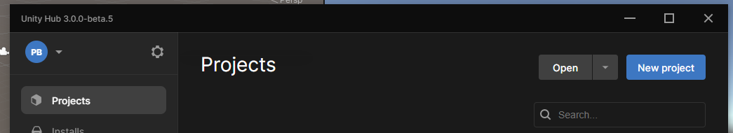
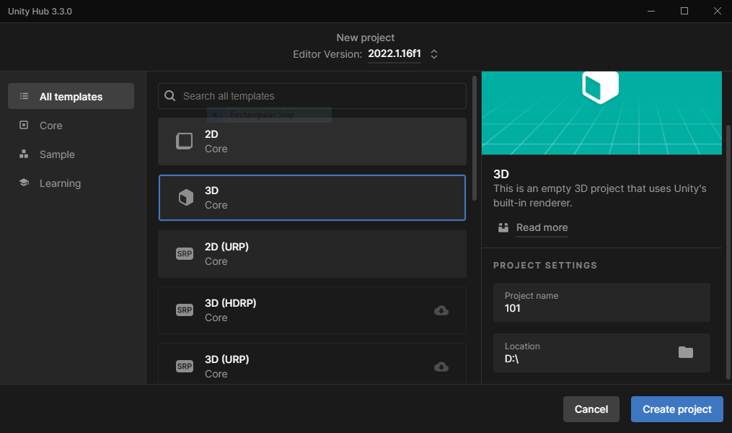
Unity Demo 101
We’re going to create a very simple program in Unity.
Open Unity Hub. Select the Project tab, and click the New Project button.
Ensure you select a 3D project. In the Project Settings, name the project 101, and change the Location folder to a suitable one. Check that the Unity version is 2022.1.16f1
If you have a different version it probably doesn’t matter too much for coding along with this demo, but make sure to remember to change it before the next class.

Slide 17
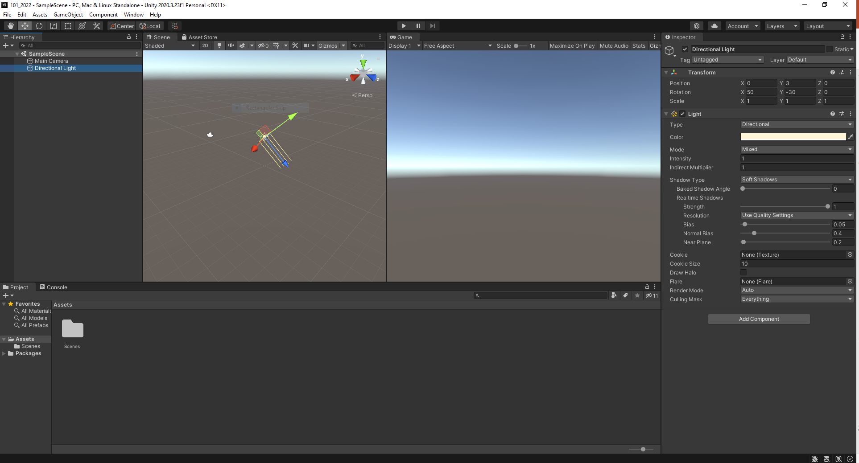
Unity Demo 101 – Unity Editor
Notes:
Talk about the various windows: how the editor is organised logically. Hierarchy.
SampleScene (can rename, can have many scenes in one Game…)
When you click on other objects in the hierarchy (scene objects) the Inspector window shows their properties.
Main Camera: Field of view over the scene. Can move the camera using scripts, or keep it static. Or can swap it out for a Character Controller which has a 1st person perspective camera.
Directional Light: Various properties we can change (e.g. we could change the lighting type to Spot or Point, change the lighting intensity, change the Shadows…
Project window – All assets (currently only Scenes folder as we haven’t added anything)
Show how to add new folders to organise things. Create one for Scripts and one for Prefabs. They will only have folder outlines as they don’t currently contain anything.
Console window – build messages, error messages and game debug messages will all appear here.

Slide 18
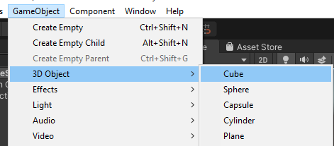
Adding a Game Object
You are going to create your own Game Object for your AR game.
However, Unity provides many ready-made game objects we can use.
Which we can then add components to, including physics components and scripts.
Let’s add a Cube.
Our cube will be placed in a default location in the scene, and will appear in the hierarchy window.
Clicking on it in the hierarchy window will enable us to view and alter it’s parameters in the Inspector window.
By default it has a Box Collider. We are going to remove this as we will discuss them later.
Notes:
Talk about the Cube properties – mesh, materials etc.
Show how we can change the position, rotation and scale of the Cube using the properties inspector, and the tools.

Slide 19
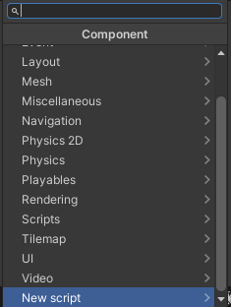
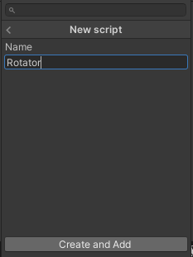
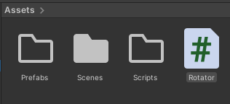
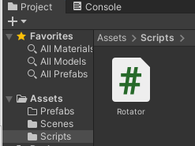
Our first Unity Script
Often we want to assign behaviours to objects: we want them to do interesting things in the game, perhaps on a timer, or based on interaction with other game objects.
To do this, we can attach a script (or multiple scripts) to the object.
Unity uses C# as the scripting language.
To add a new script, we click Add Component, and browse to New Script.
By default it adds it to the Assets folder, so we need to drag it into the Scripts folder to keep the assets organised.
The Scripts folder will then become a uniform grey colour to show it contains something.

Slide 20
Outline Unity Script
Double click on the script and it will open up in an editor.
My preference is Visual Studio, which is free for educational use. Other editors are available.
All Unity Scripts require the following skeleton code:
using System.Collections;
using System.Collections.Generic;
using UnityEngine;
public class Rotator : MonoBehaviour {
// Start is called before the first frame update
void Start() {
}
// Update is called once per frame
void Update()
{
}
}
Notes:
All Scripts are classes. They all extend from MonoBehaviour. This is in one of the collections we are importing in the script header. The must all have a Start method, which initialises the object at run-time. They must have an Update method, which is called once per frame at runtime.

Slide 21
Rotating the cube
In order to get the cube to rotate on an axis, we need to use it’s transform component.
void Update()
{
transform.Rotate(Vector3.up);
}
Save the script/ Build the solution. Wait for Unity to reload and accept the updated script (no Console error messages). Press the Play button to run the program.
We must also press Play to stop it running. This is dreadful UI design…
Any changes you make whilst the game is playing will not be saved!!!!
This will rotate the cube clockwise on the X axis at a default speed.

Slide 22
Rotating the cube
We can make the script more flexible by adding a parameter which we can change, and using a different Rotate method.
public class Rotator : MonoBehaviour {
public float rot_x;
void Start() {
rot_x = 3.49f;
}
void Update(){
transform.Rotate(new Vector3(rot_x, 0, 0));
}
}

Slide 23

Changing parameters ‘on the fly’
Now that we have declared a public parameter, rot_x, this appears listed in the Inspector window. Unity lets us modify this directly in the window to test different values without modifying the script.
We can declare parameters for the other axes too.
We can then use the Random object to generate random values for these parameters within a specified upper and lower limit.

Slide 24
Randomising parameters
public class Rotator : MonoBehaviour {
public float rot_x;
public float rot_y;
public float rot_z;
void Start() {
rot_x = Random.Range(-0.9f, 0.9f);
rot_y = Random.Range(-0.9f, 0.9f);
rot_z = Random.Range(-0.9f, 0.9f);
}
void Update()
{
transform.Rotate(new Vector3(rot_x, rot_y, rot_z));
}
}
Notes:
Show this running.

Slide 25
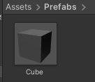

Creating Prefabs
At present, our Cube is a Game Object.
We can copy it and have multiple versions in the scene, with different parameters.
Prefabs are like reusable templates rather than Game Objects. They show up in the Project folder, and are serialized as a file on disk.
Changes made to the Prefab will affect all instances of it (all the objects of that type in the scene).
Instances of the Prefab can have their values tweaked to override the Prefab, but if you add or remove a component then the prefab connection is broken.
To create a prefab of our Cube, we simply select it in the Hierarchy and drag it into the Assets folder or Prefab folder.

Slide 26
Using Prefabs
We can drag and drop as many of them into the scene as we like.
Or we can add them using a script.
We will do this later.
The random rotational parameters means that we can have multiple cubes all rotating at different speeds.

Slide 27

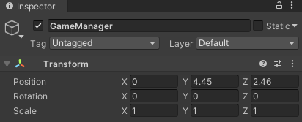
Creating Game Objects during runtime
Often, you want to create some objects when the game is running.
E.g. bullets for a gun.
We need a way of creating objects of a given class when they are needed.
One way to do this is to create an Empty GameObject to store the script(s) for this.
I usually call this object GameManager.
We can then use the Add Component menu to add a new script to our GameManager.
Let’s call it Creator.
Remember to put it in your Scripts folder.
The job of this script is to create Cubes.

Slide 28
Creating game objects using scripts
We are going to create a GameObject parameter, called go.
Then we call the Instantiate method from the Start method.
We must remember to attach our Cube prefab in the go parameter field.
Any parameter which is public appears in the component Inspector and you can interact with it.
The GameObject go is not linked to any specific object.
We have to tell it which GameObject it should be instantiating.
When we Instantiate our object, we need to specify it’s location and it’s rotation.
We will use Quaternions for the rotation as this is probably the most straightforward option.
Notes:
In the Hierarchy we now only have the camera and light, and the GameManager object. There is nothing visible in the scene. The GameManager object will create our Cube at position 0, 0, 0 with a rotation generated randomly by the Cube’s Rotator script.

Slide 29
Creating game objects using scripts
public class Creator : MonoBehaviour {
public GameObject go;
// Start is called before the first frame update
void Start() {
Instantiate(go, new Vector3(0, 0, 0), Quaternion.identity);
}
// Update is called once per frame
void Update()
{
}
}
Notes:
When we instantiate our Cube, we need to specify the location of the object, and the rotation. There are many wayus to express rotations. The most straightforward is using Quaternions.
Quaternion.identify enables us to get the rotation value.
(Quaternions are a mathematical notation for representing spatial orientations and rotations of elements in 2D space. They encode information about an axis-angle rotation around an arbitrary axis.)

Slide 30
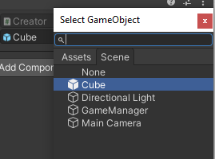


Attaching a game object to a script
If we try to run the game with this script attached, we get an error.
An UnnassignedReferenceException. It doesn’t know what go refers to.
To solve this problem, we have to attach our Cube object to the go parameter in the GameManager inspector window.
As was stated in a previous slide.
Notes:
Now this works.

Slide 31
Creating multiple objects using scripts
If we want to create 11 Cubes, we can just use a for loop, and change the x parameter for placement.
void Start()
{
for(float x = -5; x <=5; x+=1)
{
Instantiate(go, new Vector3(x, 0, 0), Quaternion.identity);
}
}
//I left out the rest of the code as it remains the same as previous

Slide 32
Creating a grid of cube objects
void Start()
{
for(float x = -5; x <=5; x+=1)
{
for (float y = -5; y <= 5; y += 1)
{
Instantiate(go, new Vector3(x, y, 0), Quaternion.identity);
}
}
}

Slide 33
Your task: Creating a grid of different shapes
Define a cube in the origin (0, 0, 0)
Add a script to the cube to make it rotate around the x-axis by a random angle
Check the documentation for prefab, game object and component, and get acquainted with these concepts
Define a cube prefab by drag-and-dropping the created cube into the project assets in a new folder you have created called Prefabs
Remove the cube from the scene and add an empty game object called GameManager.
Check the documentation for instantiate.
Add a script to the creator to make it instantiate a number of cubes in a grid pattern.
Change the script to make it create random shapes.
OPTIONAL: Change the script to instantiate the random shapes in a sphere rather than a grid.

